Slide 1

TOP Hit Prediction
Applied Data Science

Slide 2
SCOPE Identify Possible top hits based on song features
Background: Traditionally the music industry has relied on gut feelings and intuition to identify potential hits, but now data science techniques can be used to analyze song features and predict which songs are most likely to become popular/top hit.
Objectives: By analyzing the song features such as tempo, danceability, energy, and others, we aim to understand the characteristics that make a song popular. This information can be useful for music streaming platforms, record labels, and artists to make informed decisions about their music releases and marketing strategies.
Model evaluation: We will compare different models regarding accuracy, precision, recall.

Slide 3
SCOPE Identify Possible top hits based on song features
Data sources: we used four Spotify datasets provided by Kaggle. The datasets are:
3 data sets of the “Spotify Dataset 1921-2020, 600k+ Tracks”
artists.csv → Artist features like Popularity, Followers etc.
dict_artists.json → The artists recommended for fans of artists.
tracks.csv → The audio features of tracks.
1 data set of “Spotify tracks chart dataset (2014-2022)”
charts.csv → This dataset is comprised of weekly Spotify track chart data from 2014 to 2022. Used to get the chart position of the song in various countries.

Slide 4
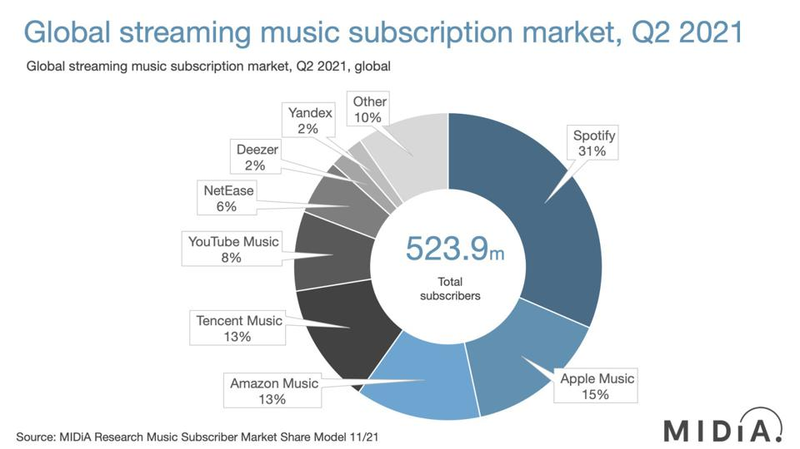
Notes:
Source: Forbes
https://www.forbes.com/sites/eamonnforde/2022/01/19/spotify-comfortably-remains-the-biggest-streaming-service-despite-its-market-share-being-eaten-into/?sh=6f71a5134743

Slide 5
Scope – Spotify API FEATURES
NAME | Description
Popularity | Measurement: Derived from absolute & recent number of streams
Energy | Liveliness of the song
Loudness | Derived from decibel measurements of the song
Liveness | Degree to which the song sounds like it was record live vs. studio produced
Danceability | Measurement of how easy it is to dance to the song
Speechiness | Measurement of words spoken
Instrumentalness | Measurement of instrumental sounds within the song
Valence | Measurement of the positivity of the song
Mode | Indication of modality (major or minor)
Excplicit | Indication whether the song contains swear words (yes or no)
Key | Standard pitch class notation (C to H)

Slide 6

Domain Exploration – Hit Song Science
Area first defined by Mike McCready in 2002 (CEO of Polyphonic)
Goal/Business Model:
Evaluate Hits before they are released
Identify & match musical preferences of certain groups
Original Procedure: Analyze mathematical structure of rhythm, changes in key & melodic pattern
Notes:
Brief literature review about domain and previous data science projects in this domain
Sources:
Ruth Dhanaraj; Beth Logan (2005) „AUTOMATIC PREDICTION OF HIT SONGS”
Internet → Web Archive 2005:
https://hitsongscience.com/
http://www.polyphonichmi.com/about_us.php

Slide 7
Domain Exploration – Previous Data Science Projects
Goals | Input | Features | Methods | Result
Predict Song Popularity (>90%) | Spotify Developer Application Programming Interface | Explicitness, Instrumentals, Danceability | KNN, Random Forest, Gradient Boosted Trees, Logistic Regr. | Max. 72% Accuracy
Predict Hit in Billboard Hot 100 | Million Song Data Set (MSD), Spotify API (Extra) | All API Features & Artist Score (Custom) & Release Time | EM, LR, GDA, SVM, DT and NN (RF) | 69 - 77% Accuracy (81 – 89% Accuracy)
Determine Variation of Attributes to Streams | Spotify API (Custom Python Code) | Genre (SF) & All API Features | Correlation Analysis, Linear Regression | Low Explanatory Power
Determine Variation of Attributes to Popularity | Spotify WEB API (Custom Code) ONE Artist | All API Features | Beta regression model, GLMM, Beta GLMM | Mixed Explanatory Power (some Pos, some neg, rest irrelev)
Determine Features of Successful Playlists | Spotify & Surveys |  | Plotting | Intimacy, Focus & Variety
Characterize Trendy Music Clusters | Spotify API | All API Features | KNN | Variety of Size & Attributes
Notes:
Sources:
L1: Dawson, Christopher E. Jr.; Mann, Steve; Roske, Edward; and Vasseur, Gauthier (2021) "Spotify: You have a Hit!," SMU Data Science Review: Vol. 5: No. 3, Article 9.
L2: Georgieva, Elena; Suta Marcella; Burton, Nicholas: “HITPREDICT: PREDICTING HIT SONGS USING SPOTIFY DATA” (2018)
L2,5: Middlebrook, Kai; Sheik, Kian: „SONG HIT PREDICTION: PREDICTING BILLBOARD HITS USING SPOTIFY DATA “ (2019)
L3: Nijkamp, Rutger “Prediction of product success: explaining song popularity by audio features from Spotify data” (2018)
L4: Spera, Carola; Sciandra, Marangela “A Model Based Approach to Spotify Data Analysis: A Beta GLMM” (2020)
L5: George John Jordan Thomas Aquinas Hayward „What makes a playlist succesful? “ (https://ghayward.github.io/assets/files/Data_Scientist_Presentation_George_JJTA_Hayward.pdf)
L6: http://www.na-businesspress.com/JMDC/JMDC14-3/8_Al-BeitawiFinal.pdf
Bias:
Accuracy Primär
Recall & Precision Sekundär
Abkürzungen:
Expectation Maximization (EM), Logistic Regression (LR), Gaussian Discriminant Analysis (GDA), Support Vector Machines (SVM), Decision Trees (DT), and Neural Networks (NN)
Random Forest (RF)
Generalized Linear Mixed Models (GLMM)
All API Features:
Danceability, Energy, Speechiness, Acousticness, Instrumentalness, Liveness, Valence, Loudness, and Tempo
Duration, Mode

Slide 8

Domain Exploration – Results
Hit Song Science is a is a field in the Data Science area, which is of great economic & academic interest
Spotify API is the best public available feature data base, providing multiple seemingly independent characteristics
Limitations of investigation:
Bias due to usage of Spotify API as main source
Primarily consists of measurable Song Information; e.g. no genres
Spotify provides no in depth details of feature calculation
Most Researches Excludes Soft Factors
Possible enrichment of the data with corresponding data
Main metric of the projects was "Accuracy" - "Precision" & "Recall" were mostly considered only secondarily, if at all

Slide 9
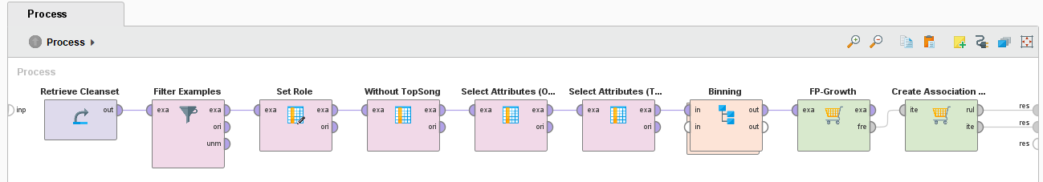
Modeling: FP Growth – Process General
Frequent Item Combinations
Result: „If Song has Feature X then it also has Feature Y“
Requirement: Need to convert features from quantitave to categorial
Bias: No direct comparision between „Top Song“ & „No Top Song“

Slide 10
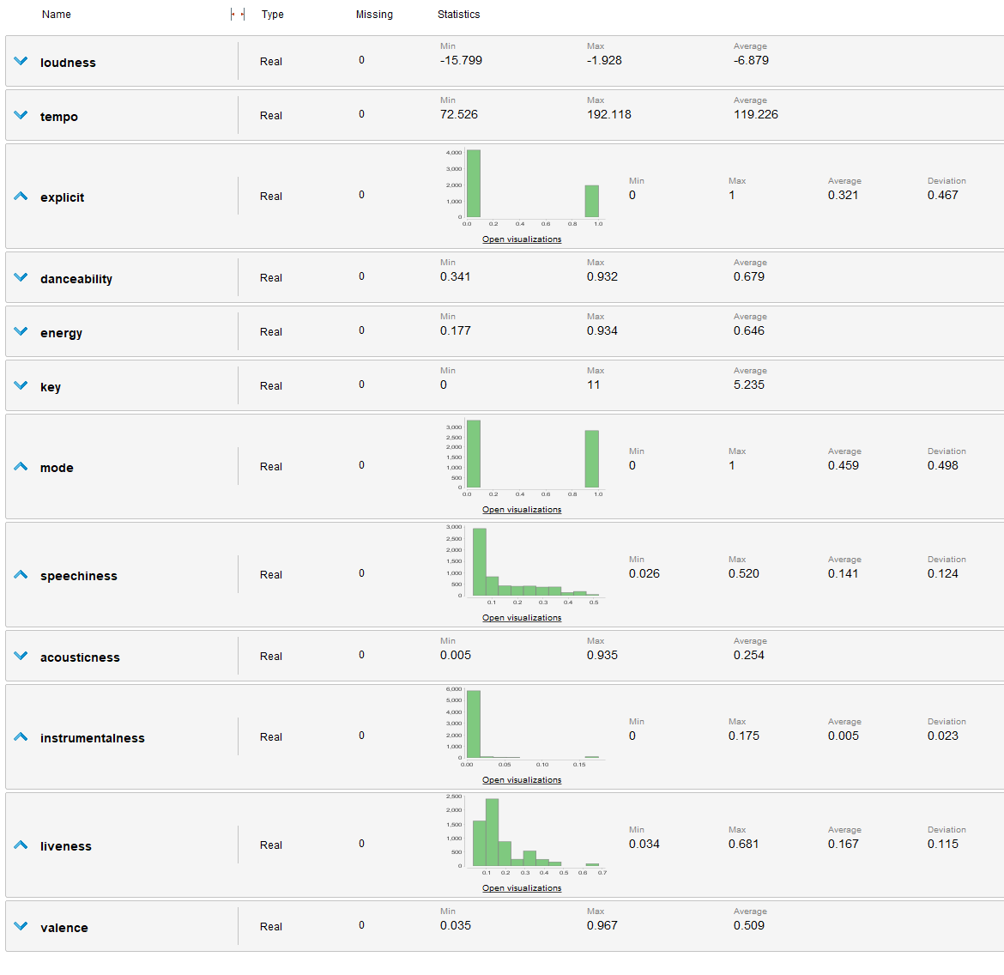
Modeling: FP Growth – Imbalanced Attributes

Slide 11
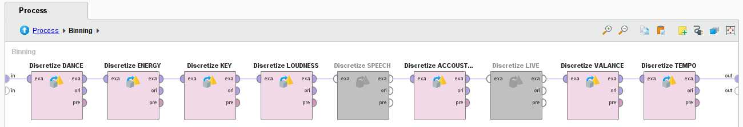
Modeling: FP Growth – Process Binning
Customized Binning
Advantage: Range adapted to the scale & classes directly readable
Disadvantage: High Manual Effort – To be adjusted with every change

Slide 12
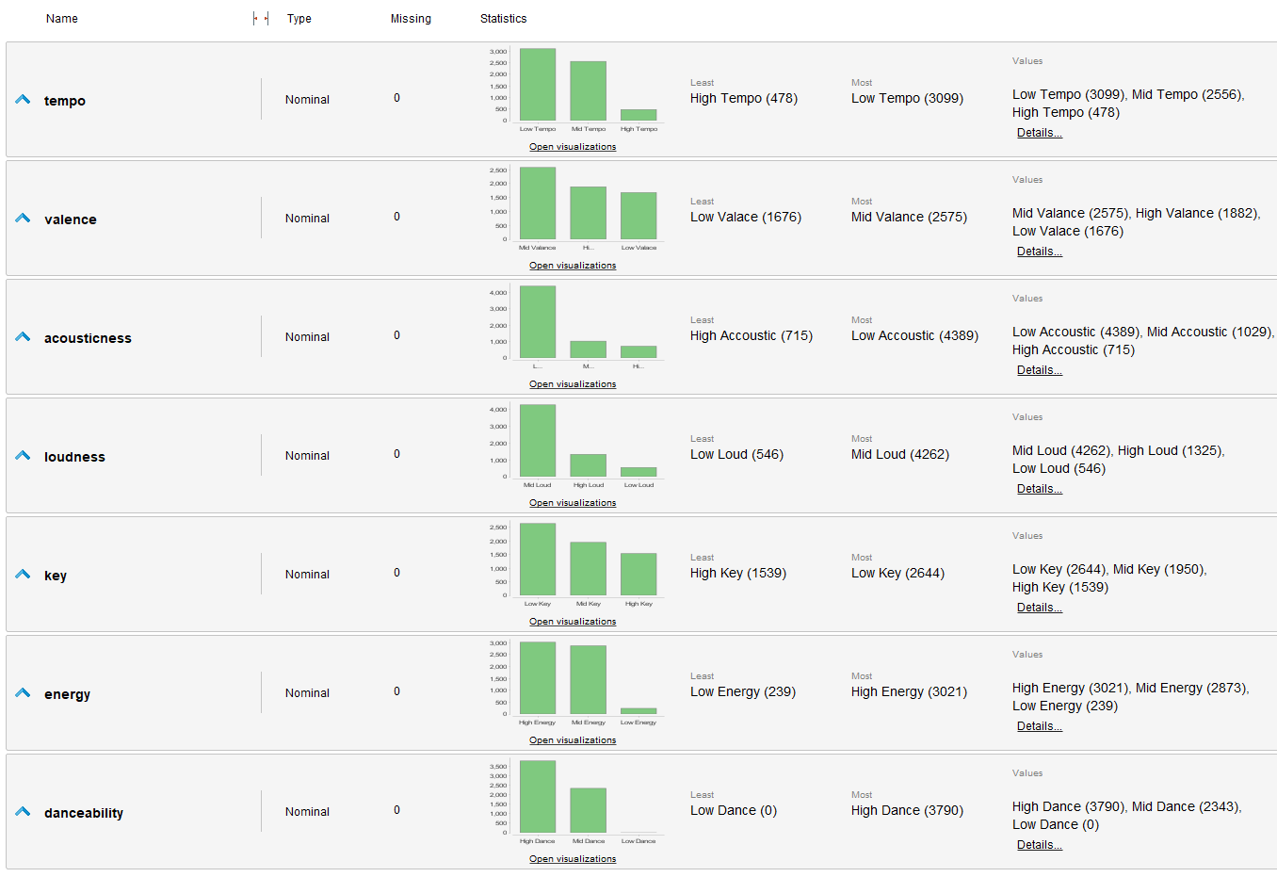
Modeling: FP Growth – Binning Result

Slide 13
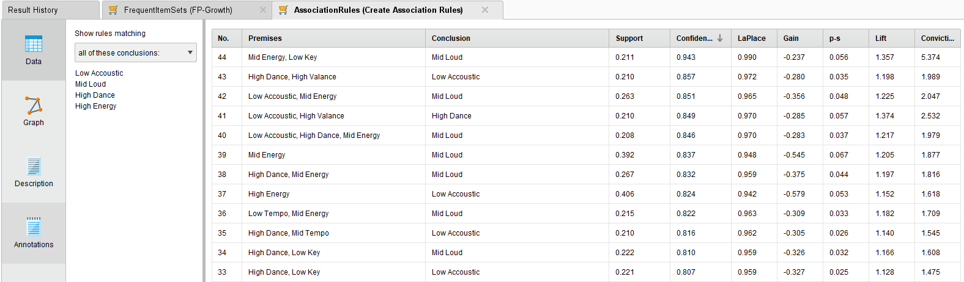
Modeling: FP Growth – Result “TRUE”

Slide 14
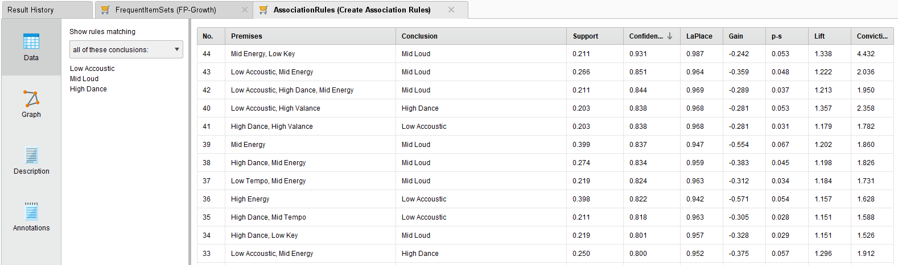
Modeling: FP Growth – Result “FALSE”

Slide 15
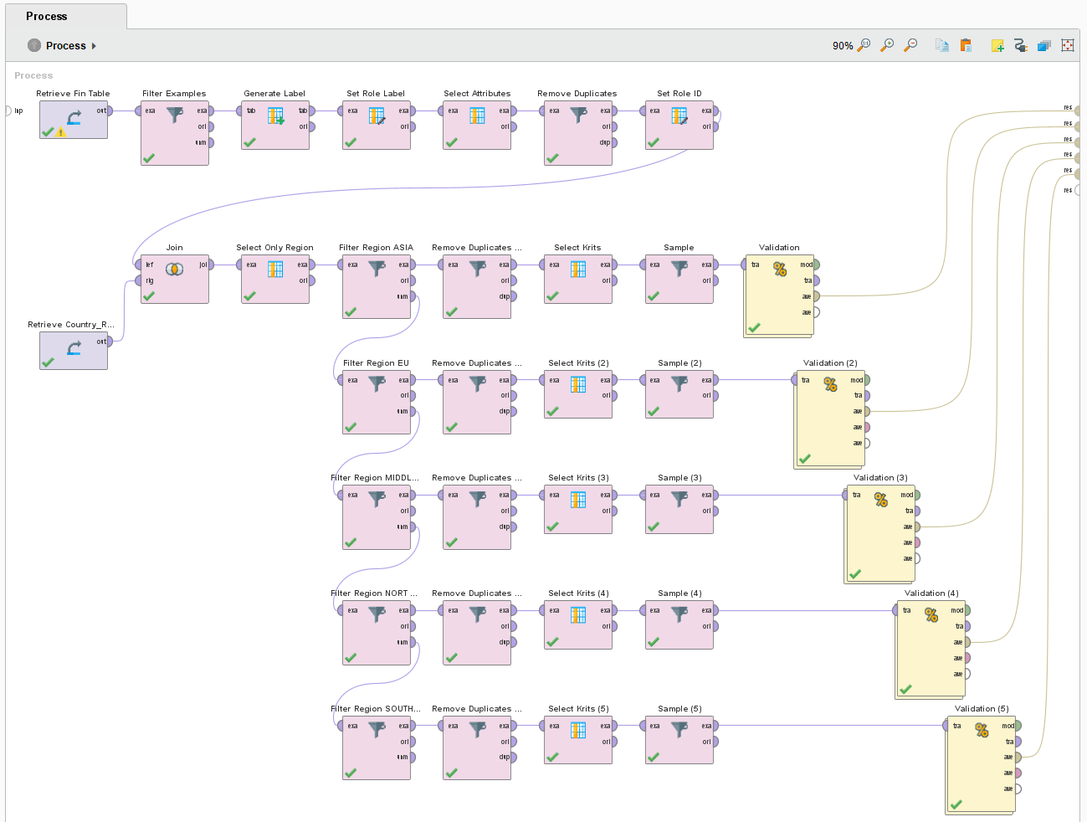
Modeling: REGION – Process General

Slide 16
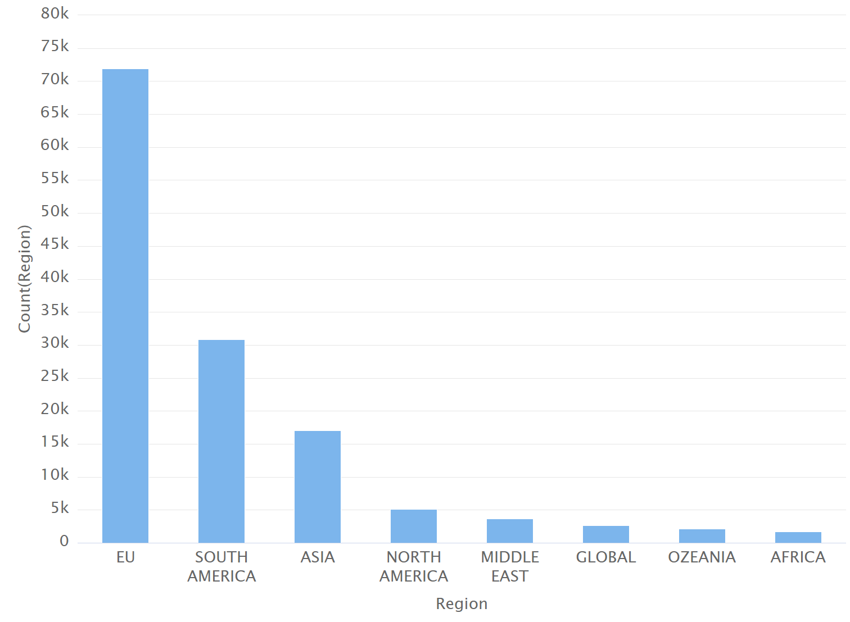
Modeling: REGION – DATA set

Slide 17
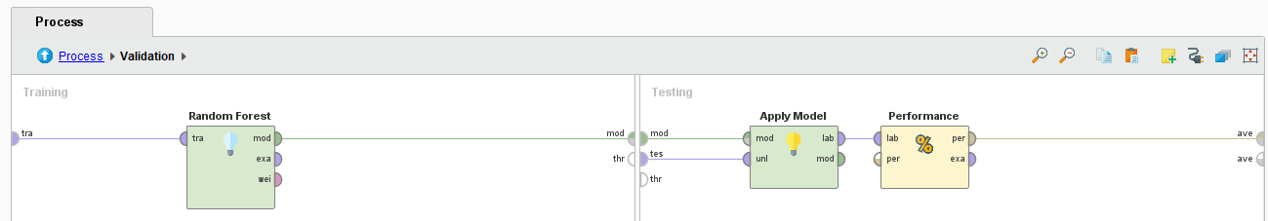
Modeling: REGION – Validation
Operator: Random Forest as its results were most pomising in previous models
Reliability highly depends on available datasets per region
Room for further Investigations

Slide 18
Modeling: REGION – Result

Slide 19
Random forest is the best performing model

Slide 20
Reflection
Genre: We did not differentiate between different genres, an improvement could be to research top songs in different genres separately (e.g pop, rock, rap,…)
Our datasets where not sufficient for those kind of research there where too special and too much genres (e.g Greek pop, Japanese R&B,..)
Time: We could also made a time series analysis. In our model we do not take into account if there where also trends during the different years or decades. Also seasonal differences could be interesting (e.g. Christmas songs, beach songs)
We find out that the popularity factor increases a lot if the artist are recommended by popular artist, but we still don´t know how the factor of recommendations are built. We could investigate in that fact more. What are the factors that a song is listed as a recommended song?
Notes:
Introduction to use case, goal, selection of data set

Slide 21
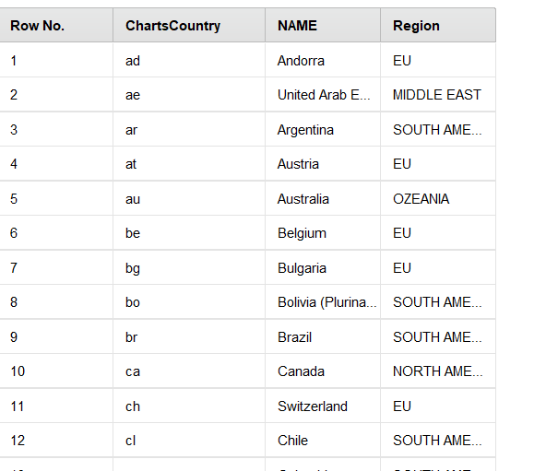
Reflection
We could also investigate more into clustering in different countries.
We started to do that and clustered charts in Regions and saw differences between different countries in accuracy for example but overall the results were not really good. We would need more data to have a reliable model.
Notes:
Introduction to use case, goal, selection of data set

Slide 22
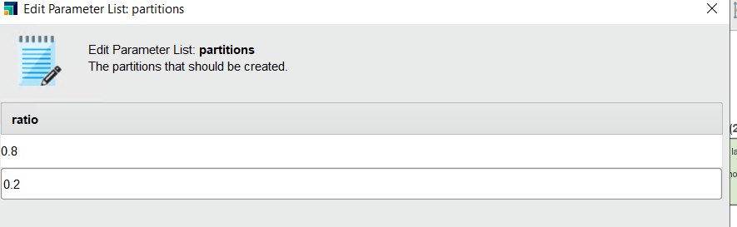
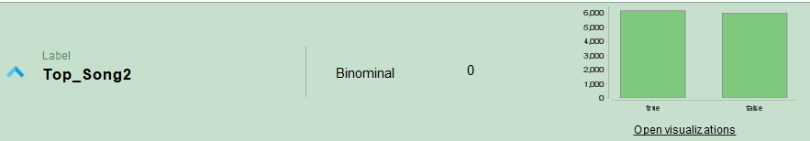
Reflection possible improvements in current Model setting
Test/Split data: We choose the 0.8/02. ratio. To improve our model we could also try it with even more or less traing data.
Sampling: We select 6000 true topsongs and 6000 false topsongs random and manually. Is there a way in Rapidminer to sample automatically?
Notes:
Introduction to use case, goal, selection of data set

Slide 23
c0nclusion
It's important to note that predicting music popularity/top song is not an exact science, and there are many factors that can influence the success of a song, such as marketing, promotion, and timing. Nonetheless, by using data and machine learning algorithms, it's possible to identify songs that have a higher probability of becoming popular/top song, and to make informed decisions based on that prediction.
Notes:
Introduction to use case, goal, selection of data set

